Slide 1
Accessibility
These slides were created by Pamela Thielman and Katherine Tsan for the Baruch College Center for Teaching and Learning.
Unless otherwise indicated all material is licensed under a Creative Commons BY-SA 4.0 license.
Notes:
Key idea:
Accessibility is falling to faculty more and more

Slide 2
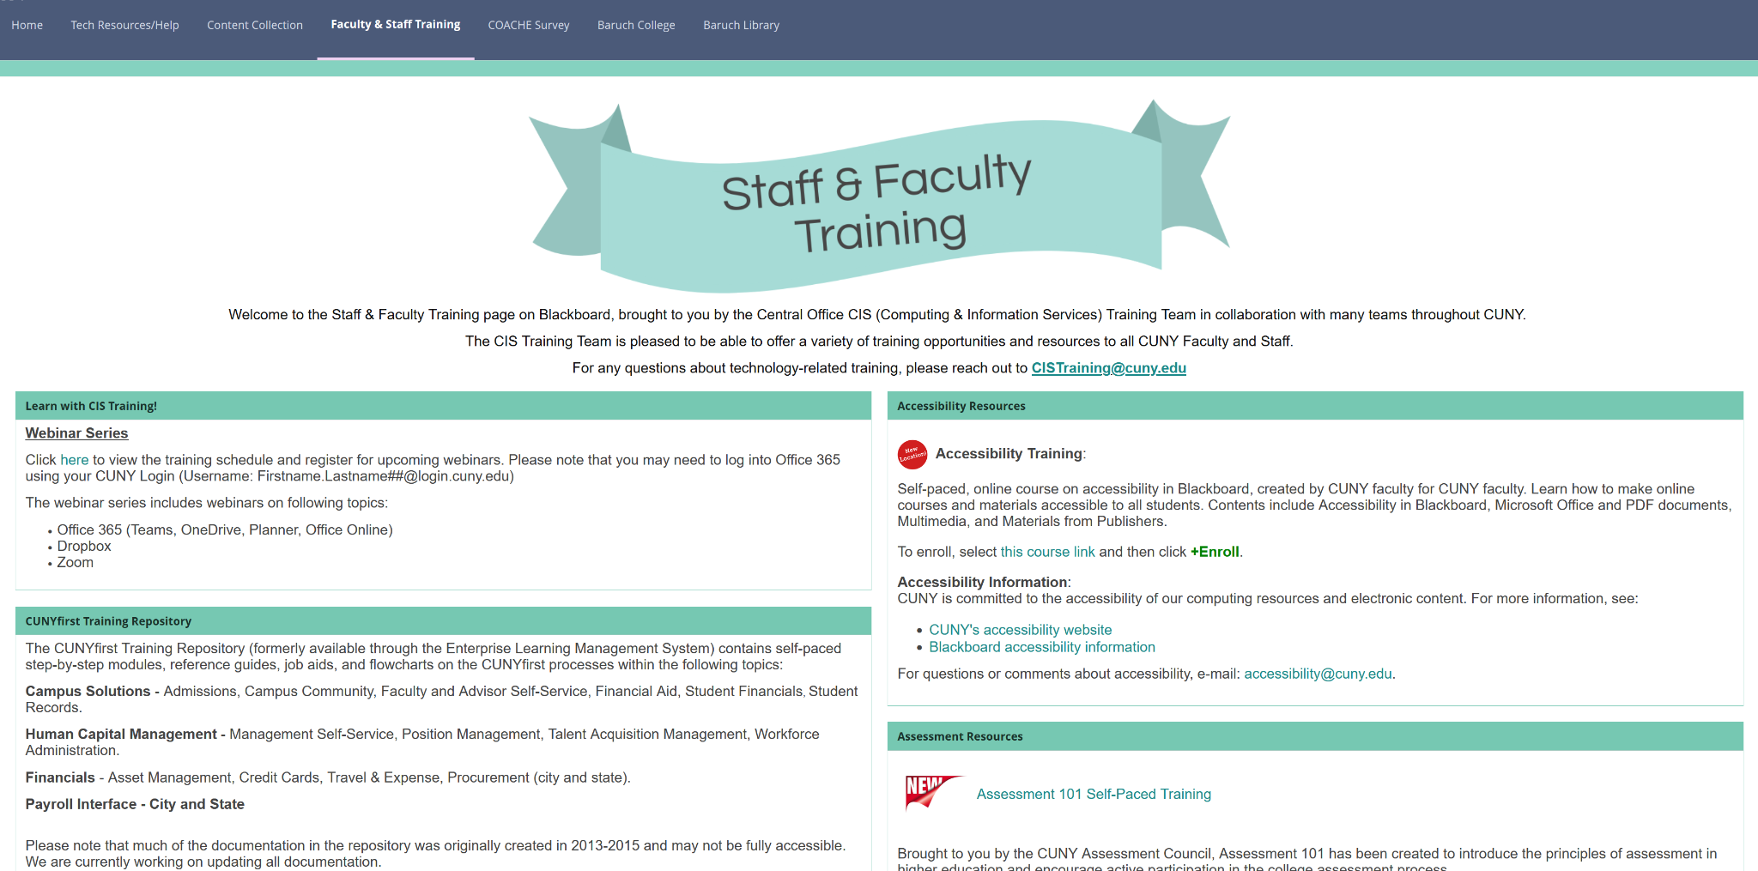
Accessibility resources:
CUNY Faculty and Staff Resources (Blackboard)
Also: Microsoft Office suite resources Google suite resources
Notes:
Key idea:
Resources are available!
CUNY-based/teaching focused
Software-specific

Slide 3
According to the Americans with Disabilities Act, disabilities that must be accommodated include:
Medical conditions
Psychological conditions
Learning disabilities
Neurological impairment
Deafness/hardness of hearing
Visual impairment/blindness
Mobility impairment
Temporary disabilities
These slides were created by Pamela Thielman for the Baruch College Center for Teaching and Learning. Unless otherwise indicated all material is licensed under a Creative Commons BY-SA 4.0 license.
Notes:
Key idea:
Lots of things fall under ADA protection, and many of them are not readily obvious

Slide 4
You primarily need to consider accessibility for:
Text
Documents
PDF
Slides
Visual media
Still images
Charts/graphs
Video
Notes:
Key idea:
There’s lots to accessibility but these will cover most of your bases

Slide 5
Basic accessibility for text
Sans serif fonts
For example: Arial, Calibri, Verdana, Roboto
Aptos (the new Microsoft default)
Readable size - minimum 12 pts. for docs and 18 pts. for slides
Strong color contrast between text and background
Avoid using red and green for emphasis
Notes:
Key ideas:
Text should be easily readable to to the largest number of people
This includes thinking about text shape, size, and color

Slide 6
Use headings and/or style options provided
Include tables of contents for multipage documents
Notes:
Key idea:
Word processing software has built-in tools to help improve accessibility
Organizational tools like tables of contents help visually impaired students and neurodiverse students who need help navigating structures

Slide 7
Other considerations
Make links descriptive:
“the Baruch CTL website”
“https://blogs.baruch.cuny.edu/ctl/”
“click here to visit the CTL site”
Notes:
Key ideas:
Screen readers read everything so descriptive links prevent clunky URLS in the text
Descriptive link are also helpful to everyone else!

Slide 8
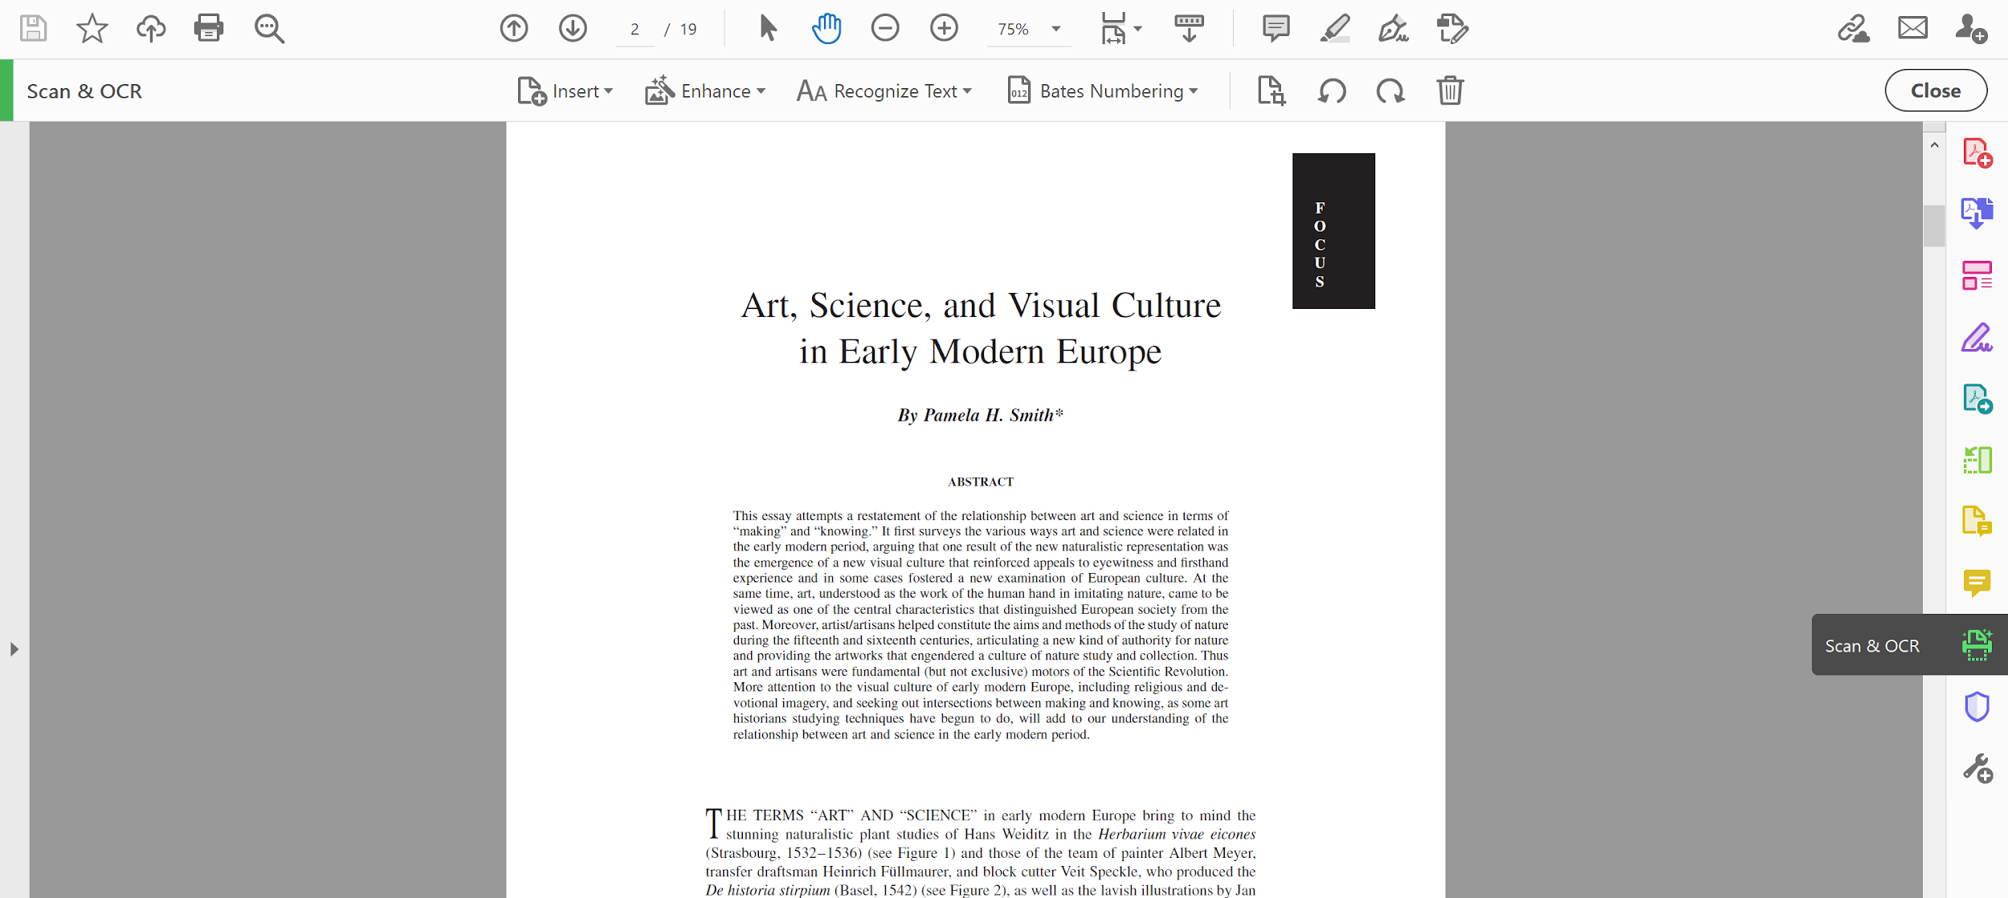
Use Optical Character Recognition (OCR)
Notes:
Key ideas:
Without OCR a PDF is just a picture of a text
OCR also makes the document searchable

Slide 9
Basic Accessibility for Media
Video captioning
Video description
Alternative text
Notes:
Key ideas:
Videos should have reliable closed captions
Commercially-produced films and library licensed materials should have captions
Youtube provides options for captioning
Video description is a newer field and there are not many options available to us (maybe ask Student Services if you run into this issue)
Alternative text explains what it in the

Slide 10
Communication is an essential professional skill.
Prem Akkaraju gives the keynote speech at Mobile World Congress Barcelona.
This image by BigShooterRT is licensed CC BY-SA 4.0 and was accessed via Wikimedia Commons.
Notes:
Key ideas:
Alternative text shouldn’t just be literal, it should describe what you want the viewer to take away from the image
Alt text can also be handy if the image doesn’t load

Slide 11
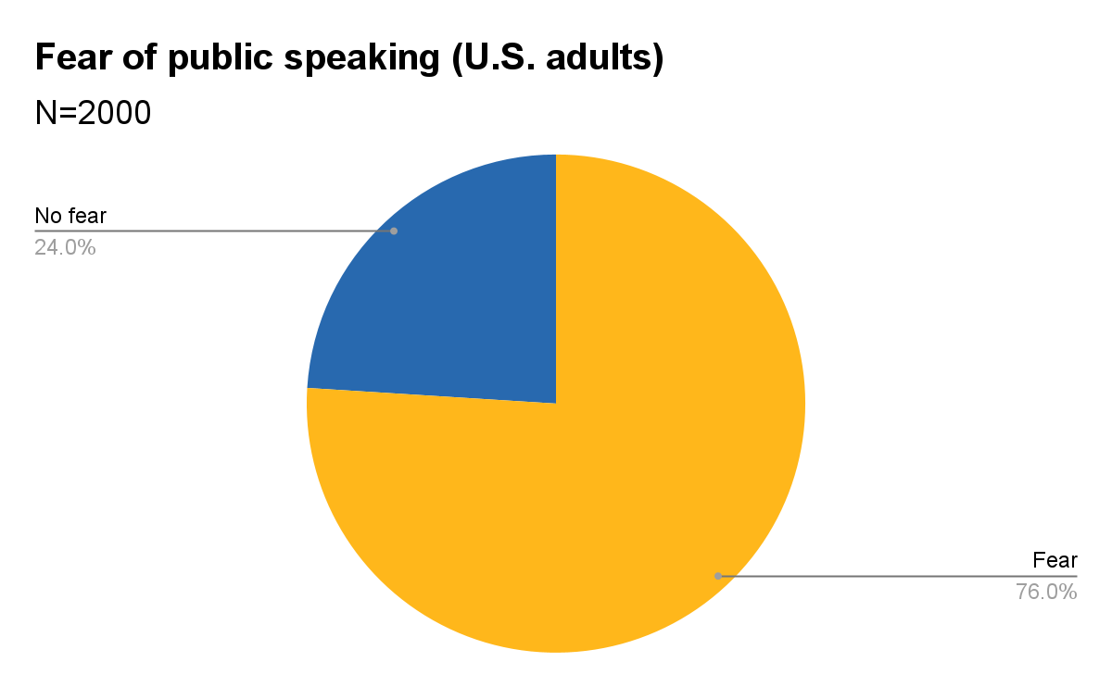
Notes:
Key idea:
Charts and graphs also need alt text

Slide 12
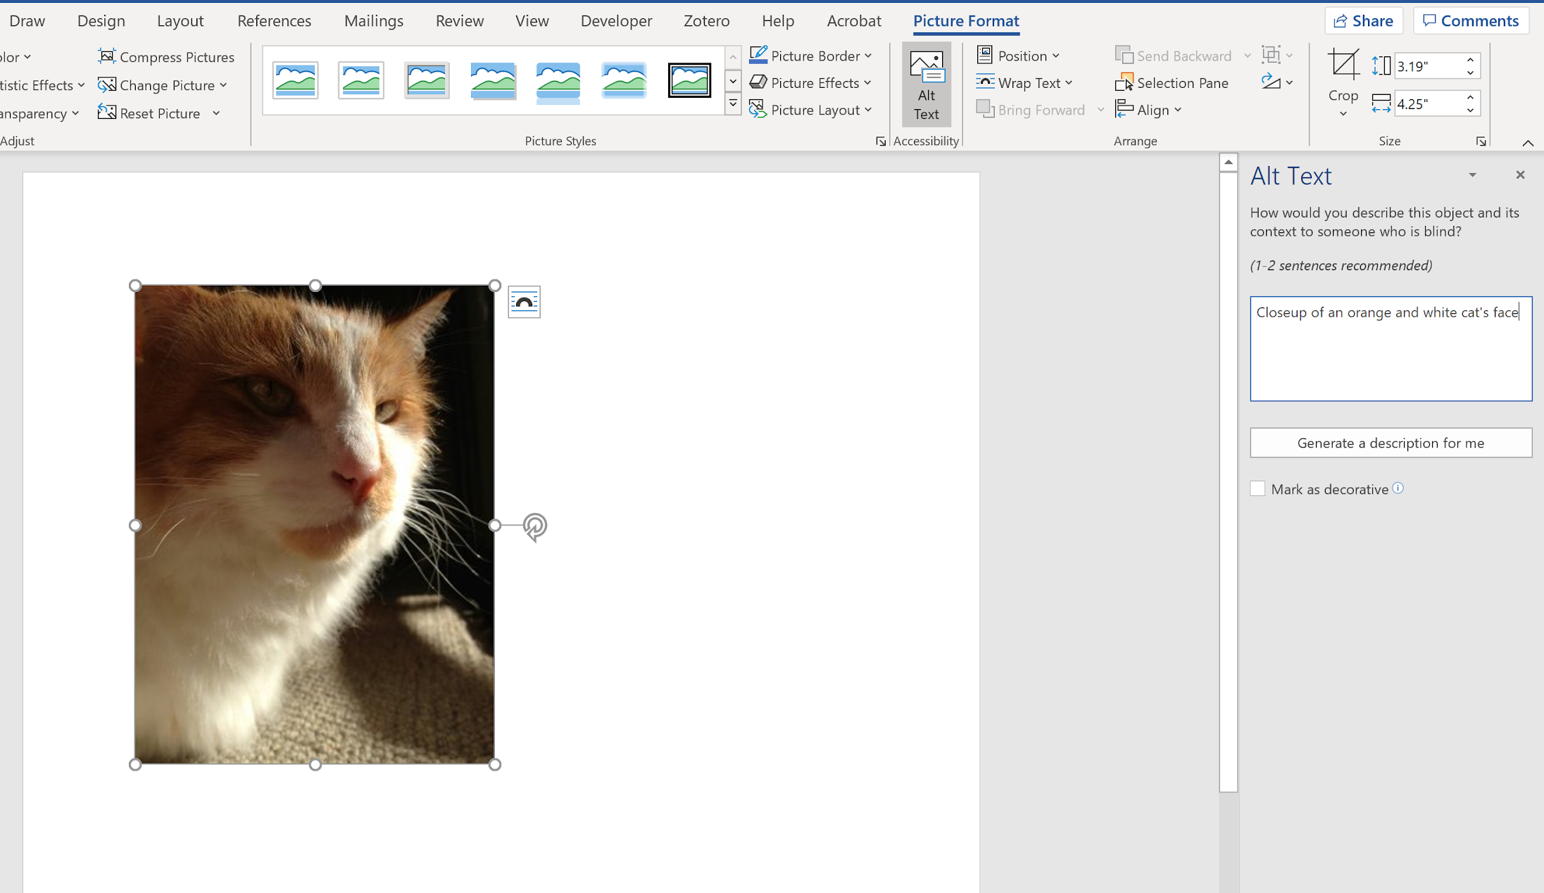
Alt text in W
Notes:
Key idea:
Alt text can be found under the image format options

