Slide 1
Defining Open Educational Resources
These slides were created by Pamela Thielman and Katherine Tsan for the Baruch College Center for Teaching and Learning.
Unless otherwise indicated all material is licensed under a Creative Commons BY-SA 4.0 license.
Notes:
Key ideas:
Again, we will share the slides after the session
You’ll hear these definitions throughout

Slide 2
The “5 Rs” of OER
Retain
Reuse
Revise
Remix
Redistribute
Notes:
Key ideas:
To be truly “open” it has to be ALL these
There are various degrees if “open”-ness
Examples
Wikipedia (text)
Wikimedia (images)

Slide 3
Retain:
Your ownership of the item is not restricted.
Notes:
Key questions:
Can you retain ownership of the item without restrictions?
Does this include making copies?
Example:
If you grab Wikipedia text you can copy & paste, download, print, etc.

Slide 4
Reuse:
You can use the item however you want, and in any context.
Notes:
Key question:
Once you have a copy of the item, can you use it however you want and in any context you choose?
Example:
You can use your Wikipedia text on a website, in a handout, incorporate it into a presentation or publication, etc.

Slide 5
Revise:
You can make changes to the item without restrictions.
Notes:
Key question:
Are you allowed to make changes to the content of the item in whatever way you want?
Example:
You can edit the Wikipedia text you grabbed (even on the site itself!)

Slide 6
Remix:
You can combine some or all of the item with other content.
Notes:
Key question:
Can you take some or all of the item and combine it with other content (either created by you or by someone else)?
Example:
You can cut together text from a couple of Wikipedia articles plus a photo from Wikimedia, and an illustration you created.

Slide 7
Redistribute:
You can share the item and any of its derivatives freely.
Notes:
Key question:
Are you allowed to share the item freely, either in its original version or with any changes or additions you have made?
Example:
You can share either the text of the original article you grabbed–or the new thing you made–with your students, colleagues, and friends.

Slide 8
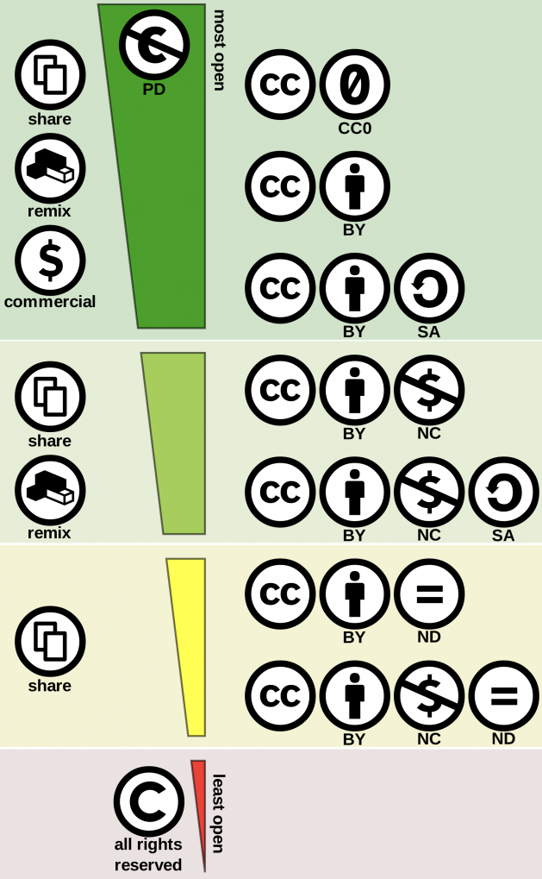
The ‘5 Rs’ are at the top of this graphic, and fully copyrighted items are at the bottom.
“Creative Commons License Spectrum” by Shaddim (CC BY)

Slide 9
The “Rs” in OER are “teaching, learning and research materials in any medium”
- 2002 UNESCO Forum on Open Courseware
Openly-licensed
textbooks
lesson plans
activities
syllabi
media
…and more!
Plus, any materials in the public domain.
Notes:
Key idea:
This is a HUGE category–on the main OER site, www.oercommons.org, you can choose by type of material.
Any public domain resource is also by definition an OER–we will talk about this in the next session, but that now includes Steamboat Willie.

Slide 10
AI and copyright
The verdict is still out on who copyright in AI belongs to.
Currently, AI works cannot be copyrighted, although this is being challenged in the courts.
AI also affords a number of possibilities in the field of open education…
Notes:
Key ideas:
Works created by AI currently cannot be copyrighted because they do not have a human creator
It may be argued that they belong to the public domain and thus are technically open source.
This issue is being litigated and we may be saying something else soon!
AI can also be useful for adapting and even authoring open texts.

Slide 11
Prompt:
In 1-2 sentences, tell us how you are feeling about what you’ve just learned about the “O” in OER?
Chatfall
Step 1
Type your response to the prompt in the chat, but don’t hit enter.
We’ll do a countdown, and everyone will hit enter at once.
Step 2
Briefly read over everyone’s responses.

