Slide 2
Finding OER and other open materials

Slide 3
Some CUNY-specific OER repositories to begin your search:
OpenEd CUNY
CUNY Academic Works
TeachOER

Slide 4
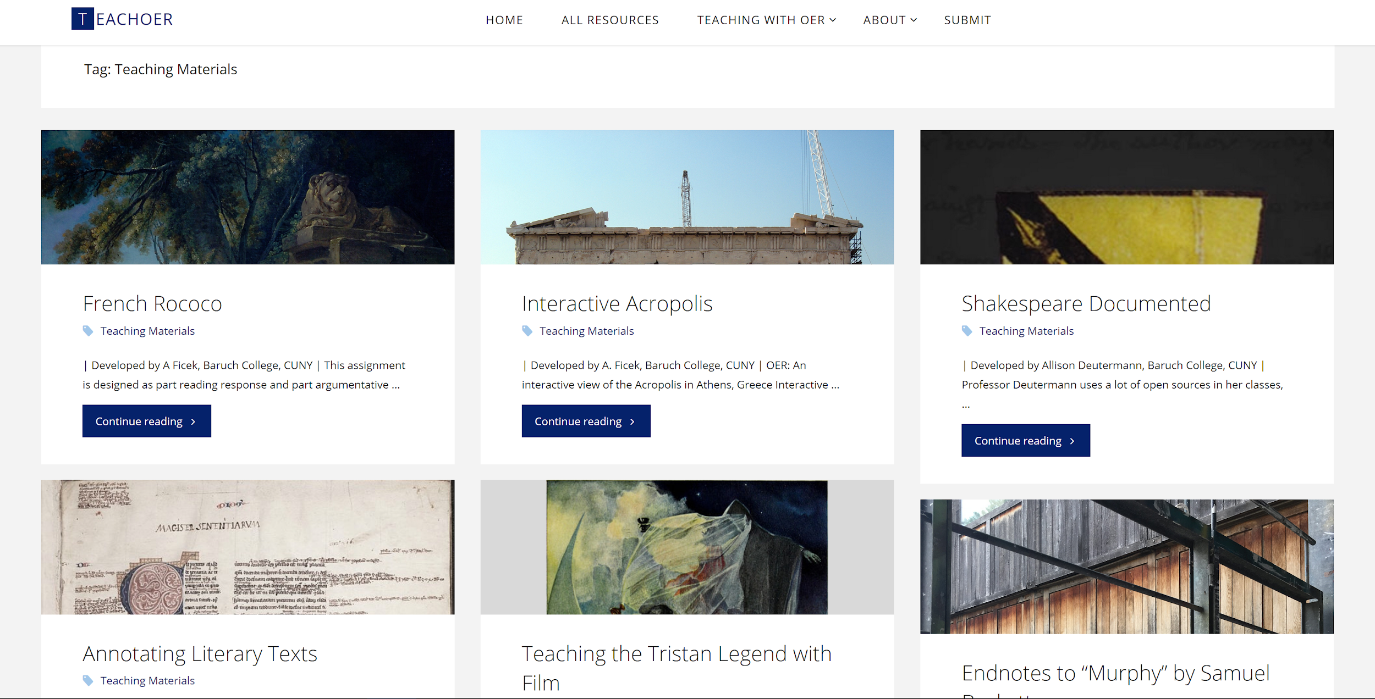
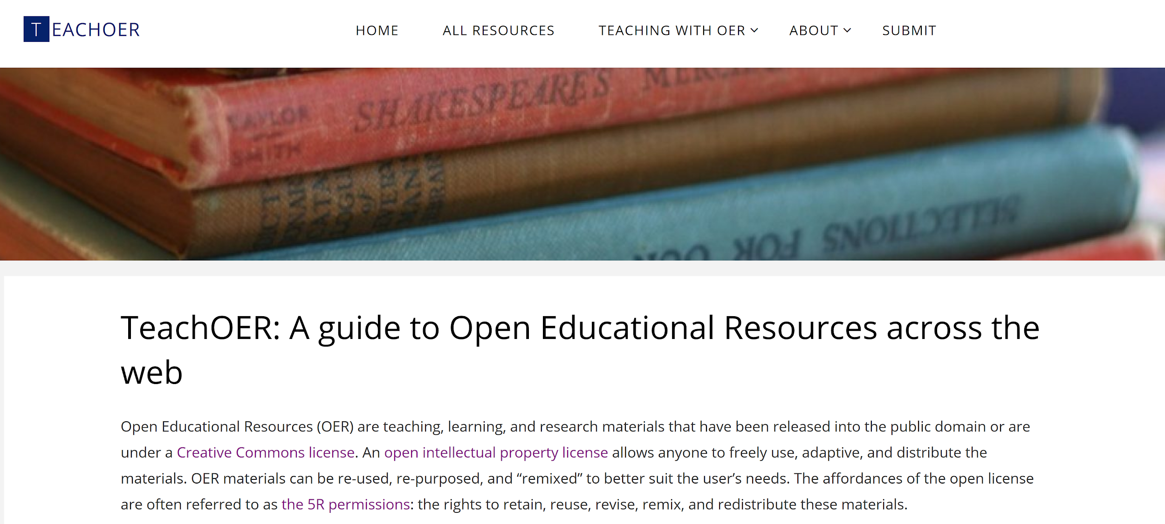
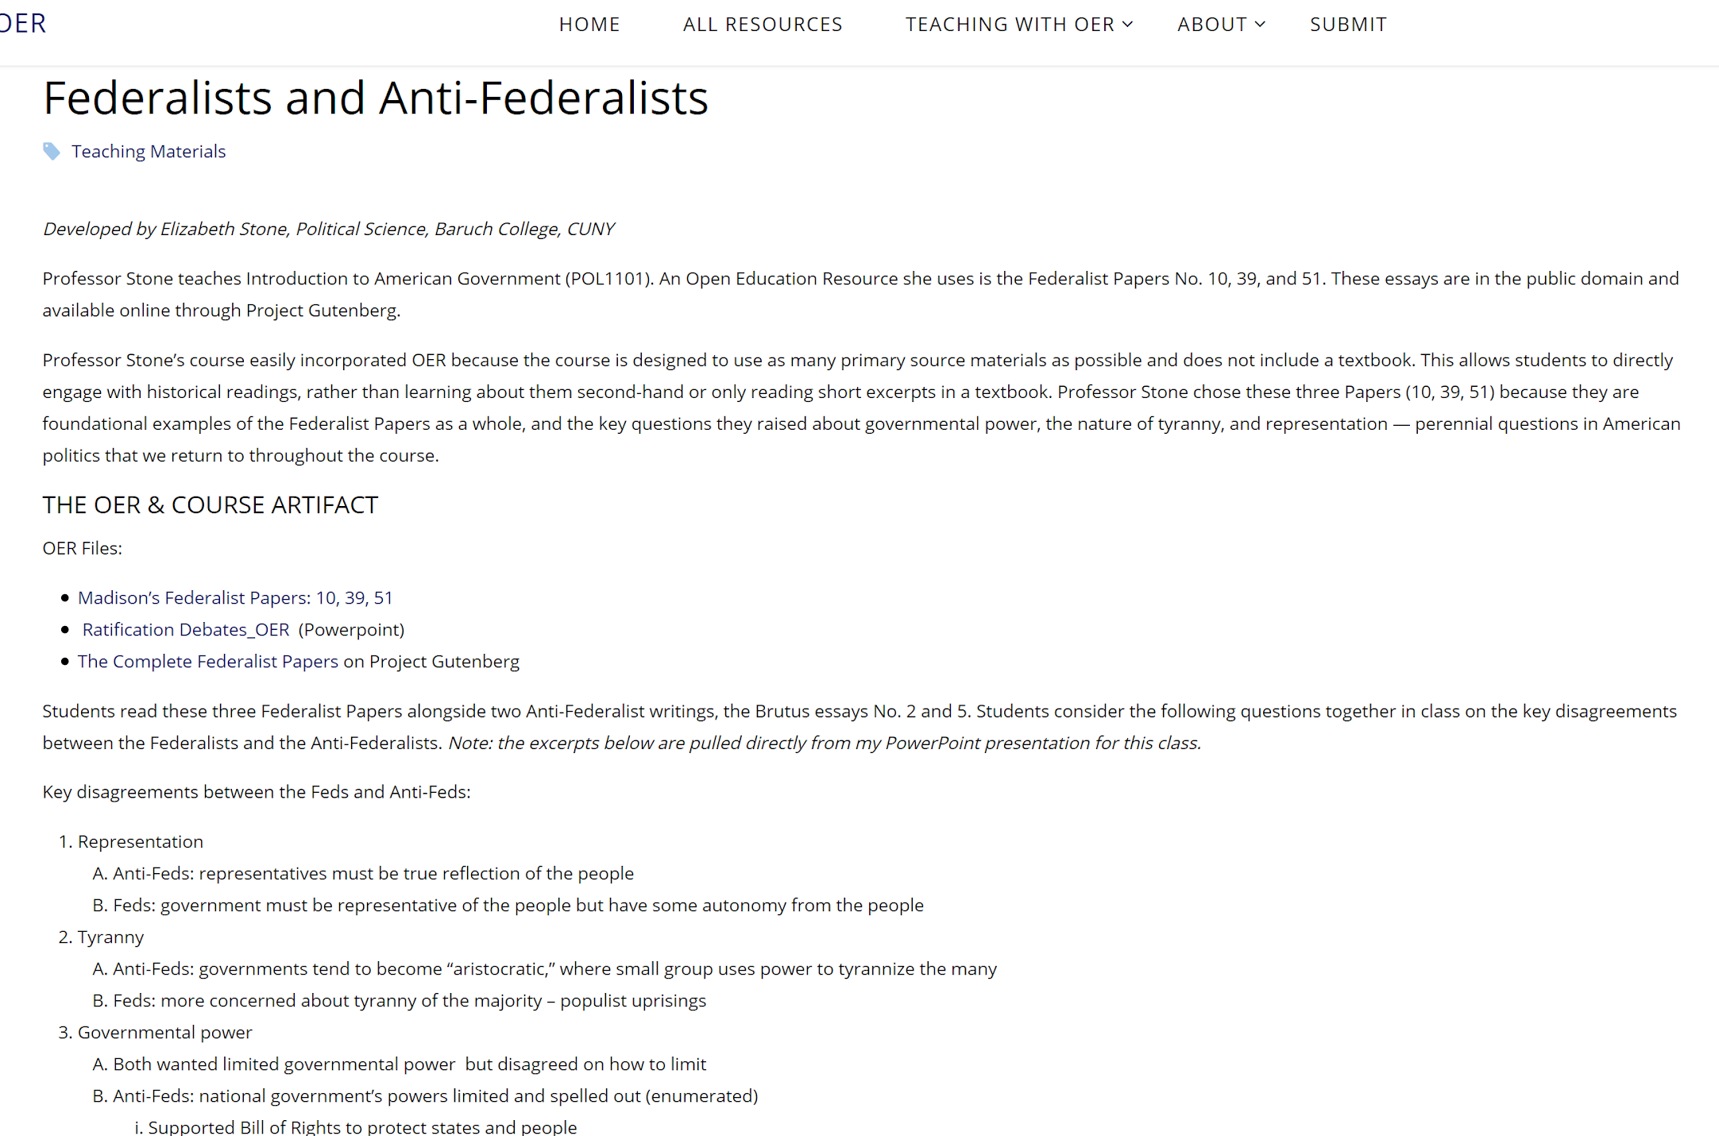
Teachoer.org

Slide 5
For a broader range of OER resources:
Open textbooks:
OpenStax
Open Textbook Library
Syllabi, activities, course modules and more:
OER Commons

Slide 6
Activity: Searching OER Repositories
Briefly reflect on the course materials you want to find (1 min.)
Go to a breakout room for a co-working session (10 min.) in which you’ll:
choose a repository
search for possible open materials for your course
note the location (URL) and licensing conditions of what you find
Report back to the main room to talk about what you found (5 min.)

Slide 7
Post-activity Chat

Slide 8
Evaluating OER

Slide 9
Consider course and/or discipline-specific criteria such as:
Learning goals
Departmental objectives
Guidelines from a professional organization
Licensure or certification requirements
Date the resource was created

Slide 10
Other things to ask:
Is the content clear and comprehensible to students at the level you teach?
Is the content well-formatted, consistent throughout, and reasonably free of errors?
Will the interface or platform be easily navigable for students?
Is the content accessible to students with disabilities?
Adapted from “Evaluating OER” in The OER Starter Kit by Abbey K. Elder, which is licensed under a Creative Commons Attribution 4.0 International License.

