Slide 1
Open-source Digital Tools
These slides were created by Pamela Thielman and Katherine Tsan for the Baruch College Center for Teaching and Learning.
Unless otherwise indicated all material is licensed under a Creative Commons BY-SA 4.0 license.

Slide 2
Open-source digital tools are…
Free to use, study, change, and distribute without limits
Available to anyone and for any purpose—the software and its source code
Meant to create shareable cultural goods and encourage public scholarship—including open educational resources (OER) and open pedagogy
Notes:
Key ideas:
Many tools used at CUNY are paid/firewalled–Kahoot, Slack, Microsoft 365, Adobe Suite
The Baruch CTL supports open tools Blogs@Baruch and Vocat
Open-source digital tools support the creation of more open materials on the internet

Slide 3
Why does choosing open-source matter?
Open-source software aligns with the same philosophies of creating OER and publicly accessible knowledge
Offers opportunities for customization
Is not proprietary and will always be freely available
Have been created and tested by users resulting in the large open-source community
Notes:
Key ideas:
Being as open as possible sometimes requires open tools (open begets open)
Reliance on the open-source community is the source of both the pros and the cons

Slide 4
When using digital tools with students, consider…
Skills (yours and the students’)
Access to technology (yours and the students’)
Time investment versus pedagogical benefits
What might complement course objectives and learning goals
Notes:
Key idea:
We do not advocate tech for tech’s sake

Slide 5
Knight Lab at Northwestern University: making information “more beautiful”
focused on open resources for interdisciplinary exploration
easy-to-use tools meant to “push journalism into new spaces”
Juxtapose: compare two pieces of similar media to explore change
Storyline builds interactive line charts and axis labels
SceneVR turns panoramic and VR-ready photos into a visual story
Soundcite lets you put audio into your story and make texts playable
...and the stars: StoryMap and Timeline JS…
Notes:
Key ideas:
In Beta: a website-making tool and SensorGrid, a project developed by the Knight Lab to empower communities, journalists and citizen scientists to accurately, affordably and efficiently monitor urban air quality.
Though, though all these are storytelling tools, they are mostly on a non-linear model, with the exception perhaps of Timeline JS which does not mean that narrative coherence is lost in the process.
What a lot of these tools offer is an interactive, dynamic process in which the lines between the author and the audience can become blurred.

Slide 6
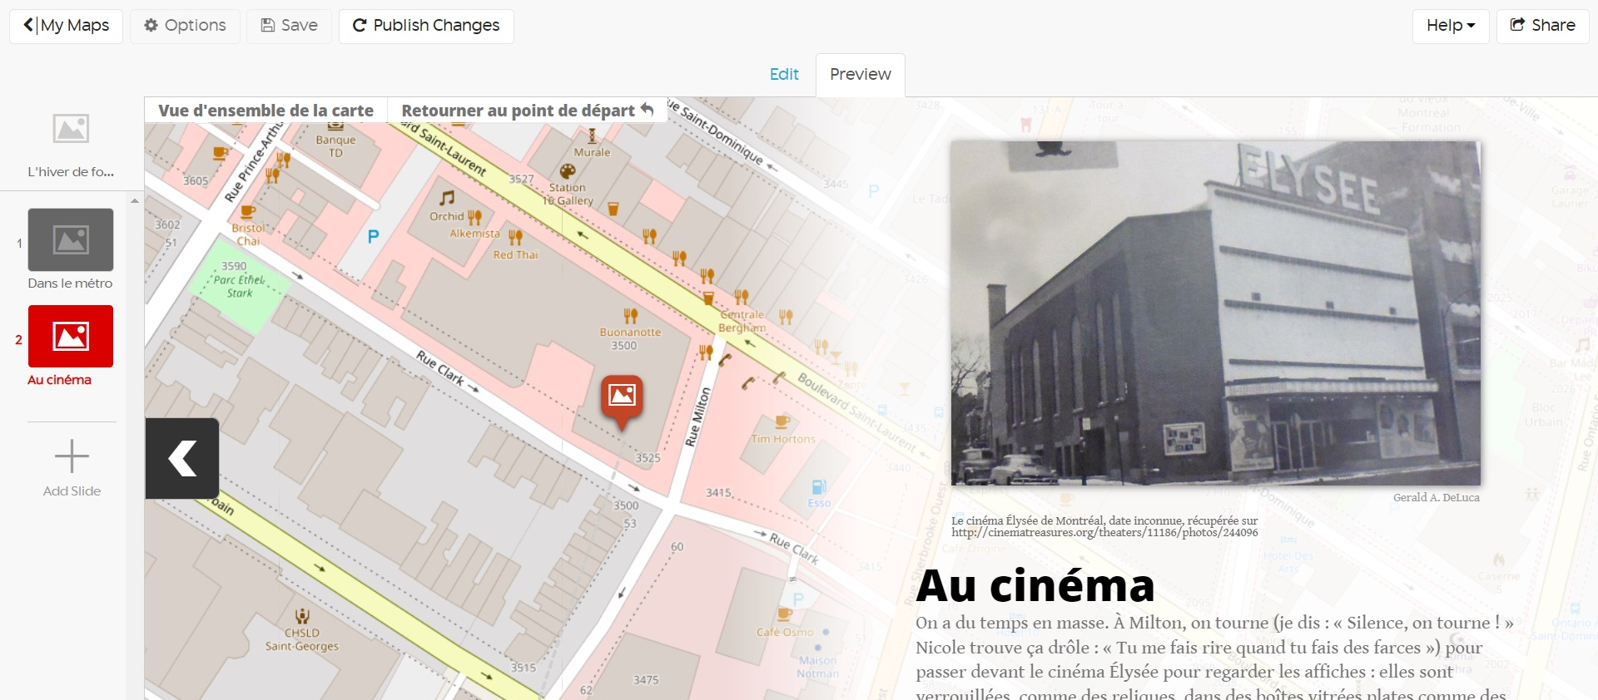
Storymap JS
User-friendly authoring tool for geographic narratives
Allows easy creation of multimedia presentations
Encourages students to think about subjects spatially
Notes:
Key ideas:
Digital storytelling has been embraced in educational settings for its potential to empower participants through personal reflection and the growth of new literacies.
The 4 elements that matter in digital storytelling:
1) community--reflection of the effect on the audience--storytellers need to think about the best way to reach the audience to whom they are speaking.
2) storytelling--the practice of organizing thoughts, economizing the text, developing tone and tightening the narrative. The act of writing engages the storyteller in reflecting on what has been learned, i.e. metacognition.
3) the storyteller engages in new literacies--usually searching for appropriate, non-copyrighted imagery, pacing it throughout the story.
4) sharing: how can the story be embedded in the right place for maximum impact?
The storyteller must also look for or create metaphorical images that enlighten, colors that enhance or even abstract images that punch up the tone or meaning of the text.
Storymap: geospatial element

Slide 7
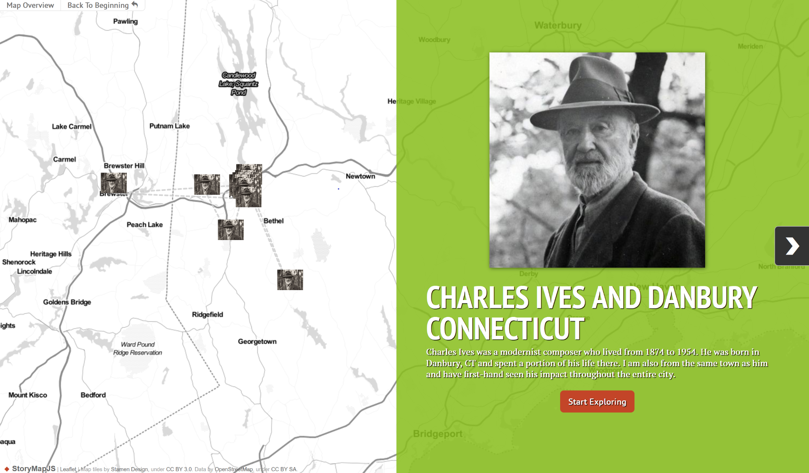
Notes:
Key ideas:
Charles Ives link: https://uploads.knightlab.com/storymapjs/b04a242a0776e24aeb88310d1493b56f/charles-ives-and-danbury-ct/index.html

Slide 8
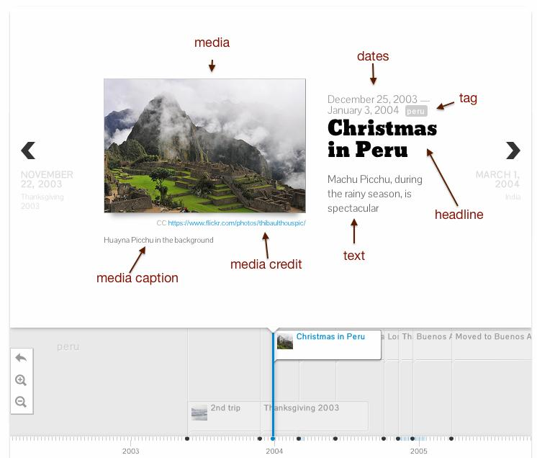
Timeline JS
Builds visually rich interactive timelines
Uses a Google Spreadsheet and an embed code generator--no HTML knowledge needed
Easily updated and edited
Can embed media
Notes:
Key ideas:
use cases: how we made something (CUNY game, student survey); 4-week guide to preparing for your class; collaboration between students
Timeline provides great practice for crediting sources

Slide 9
Notes:
Key ideas:
This is a final project in the history department (Colonial Latin America class), taught by Mark Rice, living on Blogs at Baruch. Every student came up with their own topic and timeline page.

Slide 10
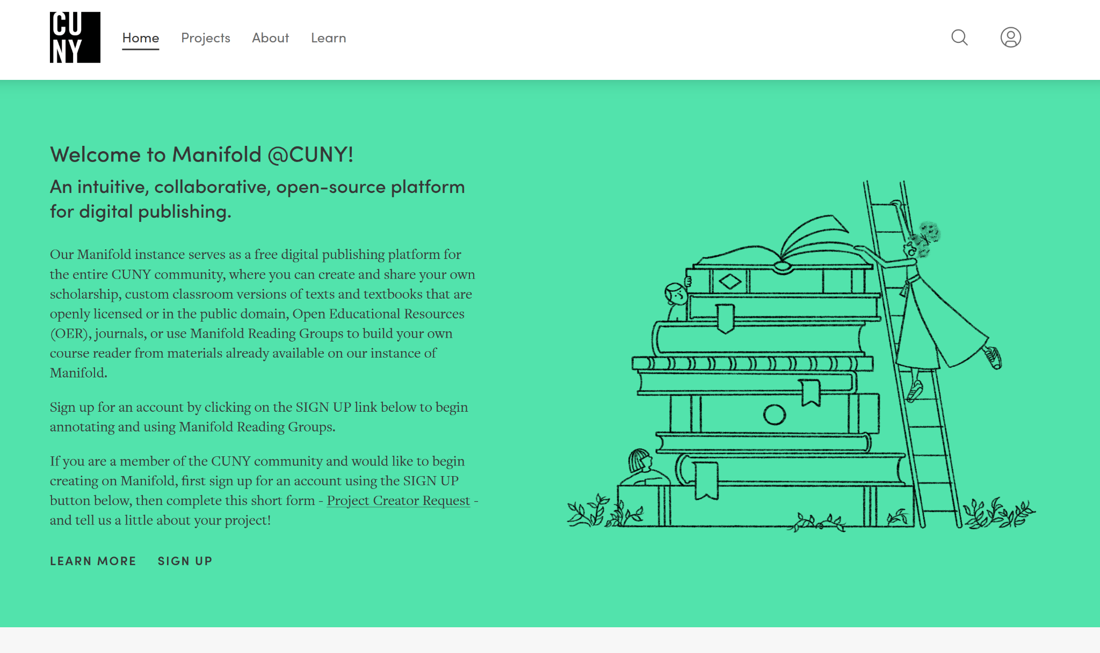
Manifold
CUNY web publishing platform widely used for course readers and projects
Social annotation options
Can embed media
User-friendly layout
Notes:
Key ideas:
Manifold is best for text-forward projects
Media is an add-on
“Projects” can be course readers, textbooks, primary sources
Also hosts the Journal of Interactive Technology and Pedagogy

Slide 11
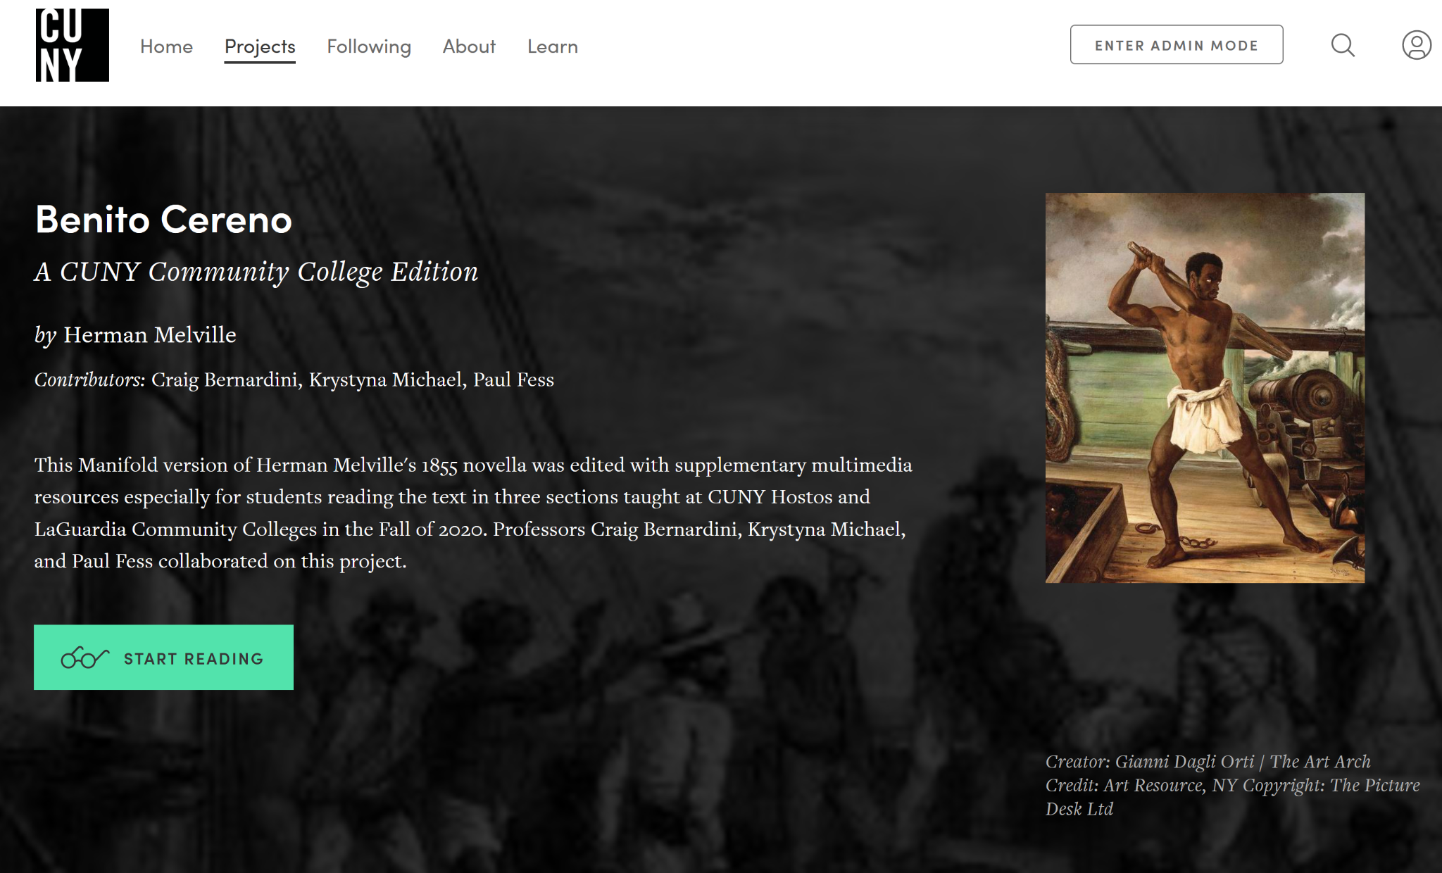
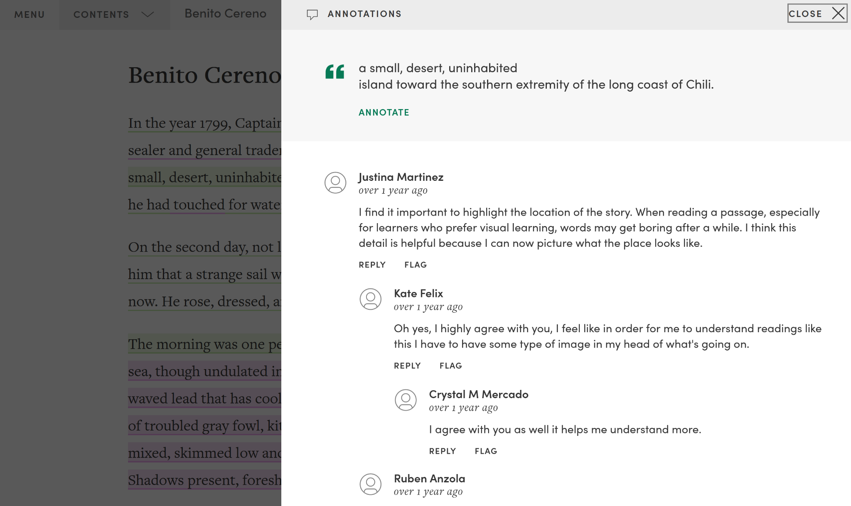
Notes:
Key idea:
Built-in annotation tools allow for public or private (class) groups annotations

Slide 12
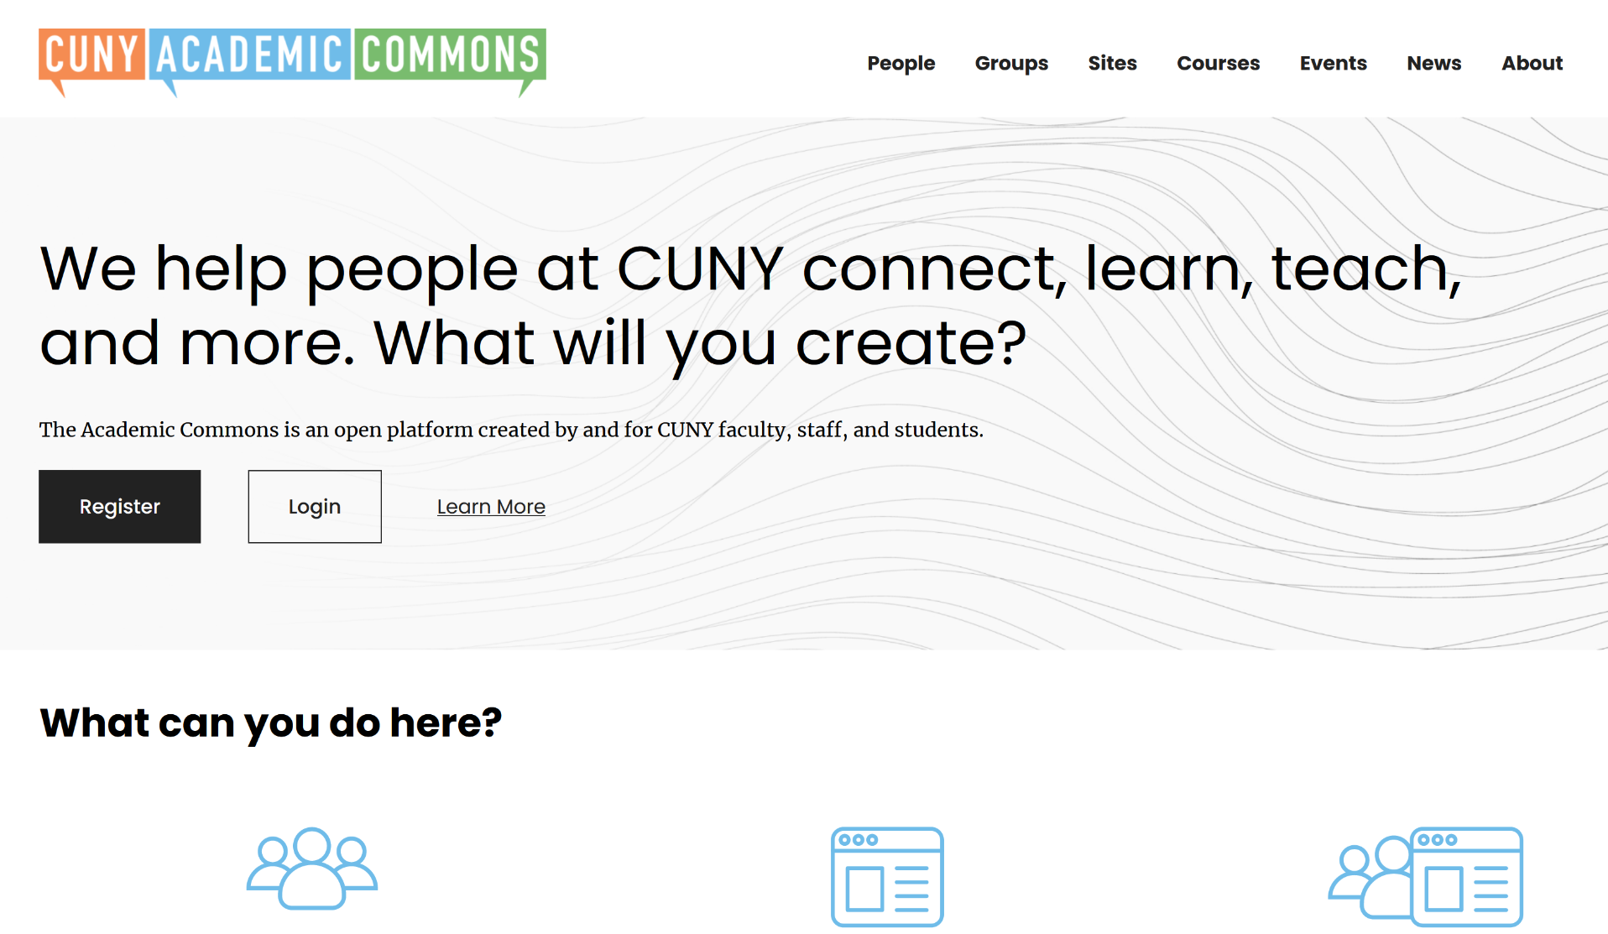
WordPress
Build course sites, projects, and more
Good for collaboration
Is available free for the CUNY community
Works with many open-source softwares
Is easily and highly customizable
Helps students develop marketable skills
Notes:
Key ideas:
2 WordPress platforms at Baruch: Blogs@Baruch and CUNY Academic Commons
Powers 43.2% of the internet (Usage statistic from 3/11/24 - https://w3techs.com)
Can be used for course sites
Student privacy may be an issue

Slide 13
Activity: Looking at open pedagogy projects
Go into a breakout room with a small group
Explore some instructor and student created open pedagogy projects (we’ll provide links)
Discuss with your partners: What tool was used to make this project? What are the licensing conditions? What do you find interesting or exciting about this project?
Be prepared to return to the main room and discuss as a group
Notes:
Example site links:
https://cuny.manifoldapp.org/projects/saying-what-we-see (Thomas May, English, Baruch)
http://teachoer.org/communications/syllabus-game-com-1010/ (Pamela Thielman, Communication Studies, Baruch)
https://cuny.manifoldapp.org/projects/open-access-case-studies (Alexander Núñez Torres and Martha Lerski, Business, Hostos Community College)
https://bgccraftartdesign.org/ (Catherine Whalen with Kimon Kermidas, Design History, Bard Graduate Center)
https://uploads.knightlab.com/storymapjs/ab4553c0d2fe39bd14e9c54bc3c08571/smith-and-burney-sample/index.html (Catherine Keohane, English, Baruch)

Slide 14
Let’s Discuss!
Can you imagine yourself incorporating an open pedagogy assignment in your class? What might that look like?

