Slide 1
What about “zero-cost” resources?
These slides were created by Pamela Thielman and Katherine Tsan for the Baruch College Center for Teaching and Learning.
Unless otherwise indicated all material is licensed under a Creative Commons BY-SA 4.0 license.
Notes:
Key idea:
You hear us saying OER/ZTC and may be wondering what the difference is. Zero cost is the official Baruch designation for an OER course, in CUNY first.

Slide 2
“Zero cost” = no direct cost to students or faculty
library-licensed materials
content on public websites
newspaper or magazine articles
items from museum collections
blog or social media posts
…and more!
materials used under the “fair use” exception to copyright✱
✱We’ll talk more about this in session 2, but always ask a librarian for guidance about fair use!
Notes:
Key ideas:
Everything that is OER is zero-cost but not everything that is zero-cost is OER
Examples: NYTimes, online content, an article from the library database.

Slide 3
One goal of the OER Initiative is to convert courses to ZTC
ZTC courses/sections:
do not require students to purchase course texts
may include library materials and/or other zero cost materials
may include recommended readings that are cost-bearing
students may be asked to pay for some items (ex: calculators, event tickets)
ZTC courses at Baruch may use OER and/or zero cost materials.
Notes:
Key ideas:
You can use both at Baruch
We will encourage you to choose “open” when possible

Slide 4
For those who can’t go ZTC, “Low Textbook Cost” might work
LTC courses/sections:
require students to purchase no more than $25 in course materials
may include recommended readings that are cost-bearing
students may be asked to pay for some items (ex: calculators, event tickets)
LTC courses at Baruch may use any combination of materials costing up to $25.
Notes:
Key ideas:
LTC works when you have inexpensive materials you can’t/don’t want to get rid of.
We will STILL encourage you to choose “open” when possible

Slide 5
Activity: What materials are you already using?
Choose a syllabus you would consider converting to ZTC
Choose 3 methods of marking (ex: colors, symbols, line types)
Use a different method to mark
cost-bearing course materials
zero cost materials (ex: newspaper articles, TED Talks, library materials)
OER (ex: open textbooks, gov’t data, primary source documents)

Slide 6
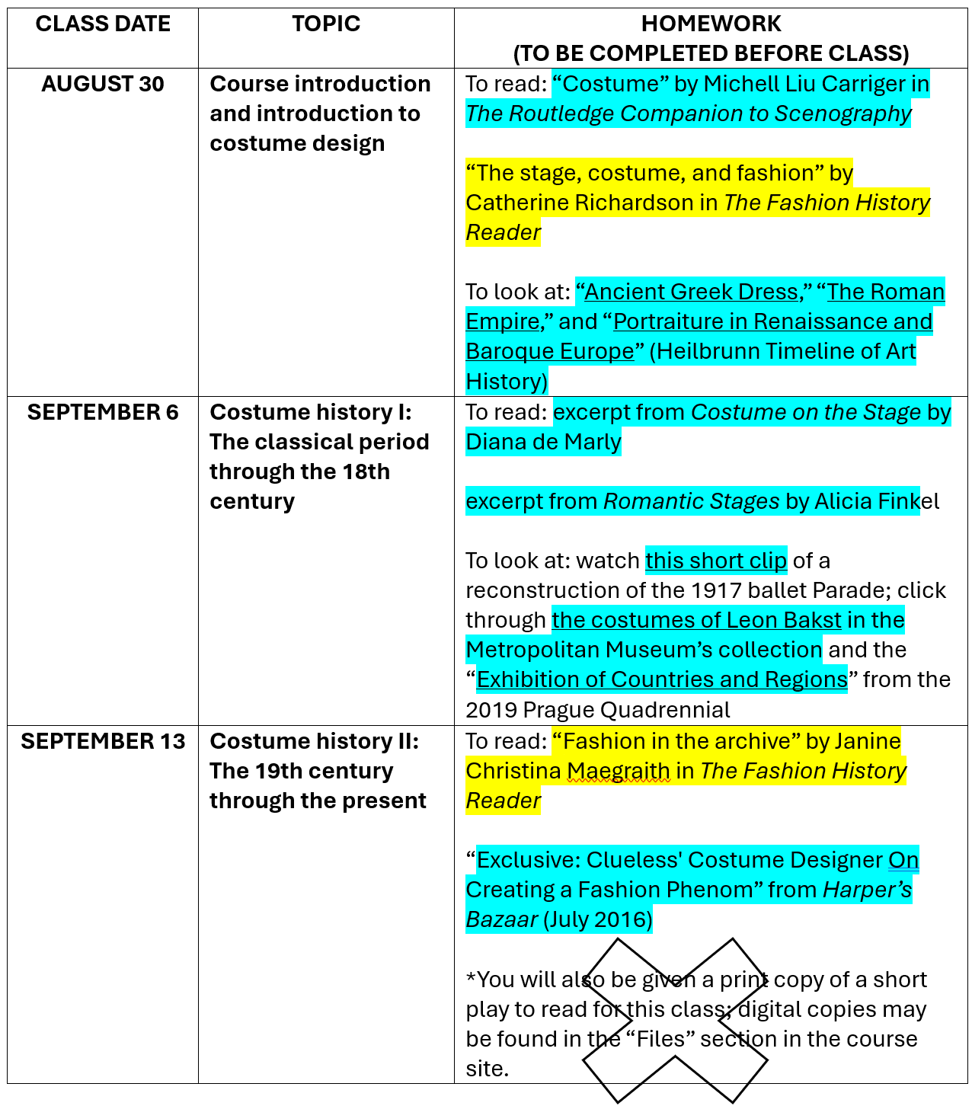
yellow=cost-bearing
blue=zero cost
X=copyright infringement 😟

Slide 7
Discussion: What would converting to “Zero Textbook Cost” look like for your course?

Slide 8
Activity: The Old Régime and the OER Revolution
Follow along as we explore this OER created with the open-source tool Twine
Keep track of questions that arise as we go through the content together

Slide 9
Consider:
What brought you to the OER Seminar?
What would you like to know more about?

